Slide 1

Kaizen SUST
Continuous Development
1

Slide 2
Welcome to
Kaizen SUST
“Kaizen SUST”, a research-based organization of Shahjalal University of Science & Technology, Sylhet. Kaizen SUST was started in the year 2011 by some skilled, intelligent and inquisitive young students of SUST with the purpose of various activities related to science and engineering and with the motto "Continuous Development". “Kaizen SUST” has already come a long way with continuous success. “Kaizen SUST” is currently being successfully implemented in 2023 under the supervision of the 12th Committee.
1

Slide 3

Kaizen SUST’s
Vision & Mission
“Kaizen SUST”, a research-based organization of Shahjalal University of Science & Technology, Sylhet. Kaizen SUST was started in the year 2011 by some skilled, intelligent and inquisitive young students of SUST with the purpose of
Sustainable System
Industrial Automation
Engineering Drawing
Skill Development
1

Slide 4
Skill
Development
1

Slide 5
Skill
Development
1

Slide 6
On Going Projects
1

Slide 7
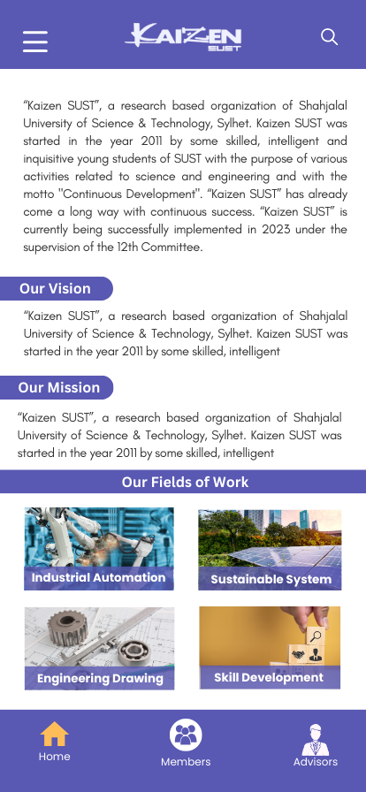
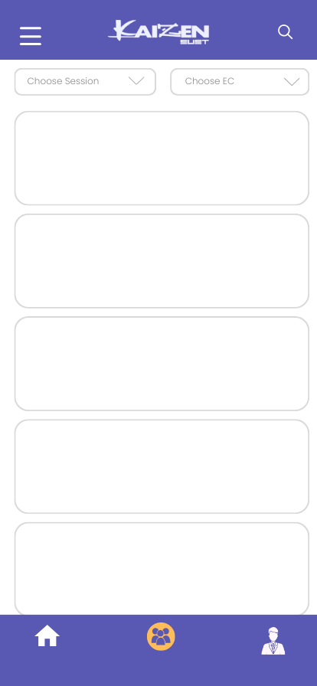
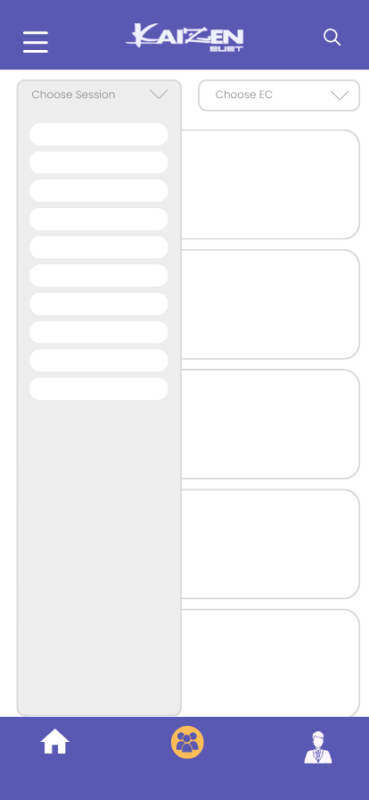
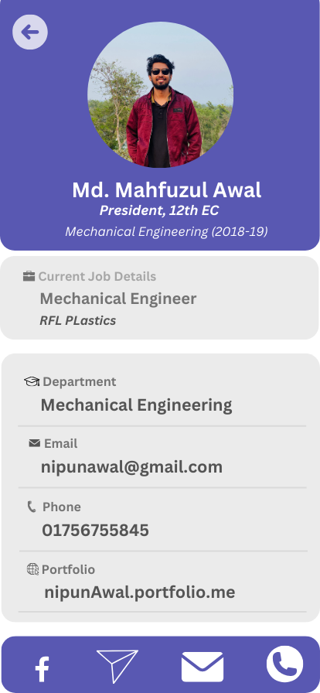

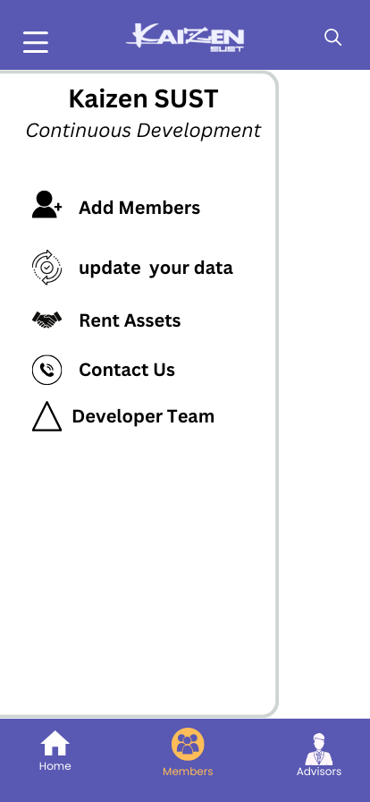
Kaizen Sust App
1

Slide 8
Future Projects
1

